Slide 1
DSC 530 Final Project
Christine Hathaway

Slide 2
Statistical Question/Hypothesis
Every year on Groundhog’s Day in Pennsylvania, a prediction is made, whether or not there will be an early spring, based on the groundhog seeing or not seeing his shadow.
Question: Is there a positive correlation between the groundhog’s prediction and the onset of spring?
I will attempt to answer this question using data with the average temperatures for February and March, along with the result of the prediction

Slide 3
Dataset Variables
year is an integer of the period of record
result contains the results of the groundhog’s prediction, or if there is no record
feb_avg is a decimal of the average temperature of all regions in February
feb_avg_ne is a decimal of the average temperature of just the Northeast region of the United States in February
feb_avg_mw is a decimal of the average temperature of just the Midwest region of the United States in February
feb_avg_pn is a decimal of the average temperature of just the state of Pennsylvania in February
mar_avg is a decimal of the average temperature of all regions in March
mar_avg_ne is a decimal of the average temperature of just the Northeast region of the United States in March
mar_avg_mw is a decimal of the average temperature of just the Midwest region of the United States in March
mar_avg_pn is a decimal of the average temperature of just the state of Pennsylvania in March
result_num is an integer converting the results to either 0 for no shadow or 1 for partial/full shadow
These variables will help show whether the temperatures for February and March followed the groundhogs prediction of an early or late spring.

Slide 4
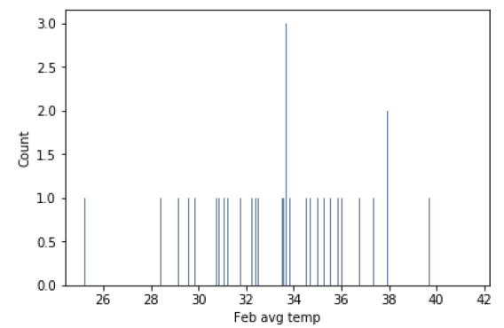
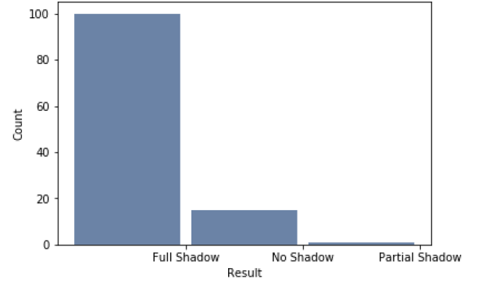
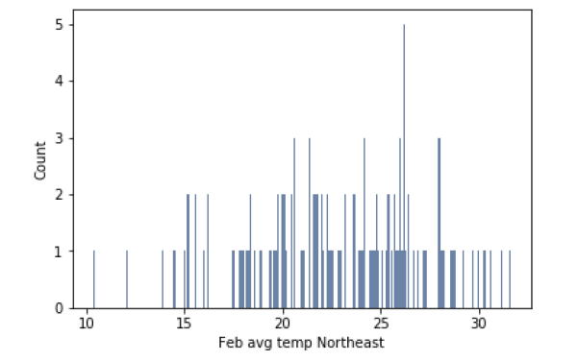
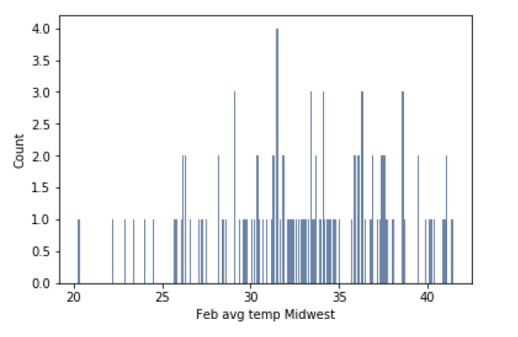
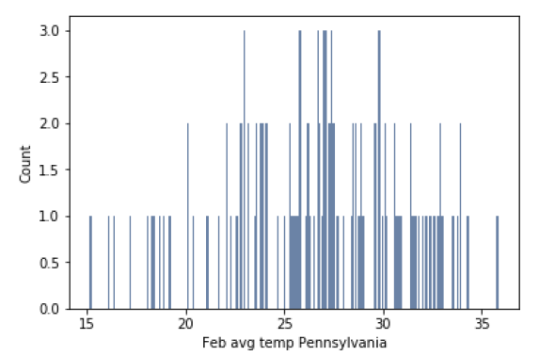
Variable Histograms

Slide 5
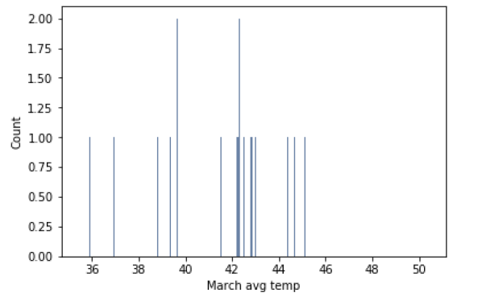
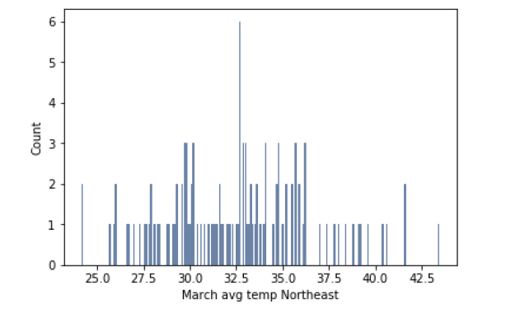
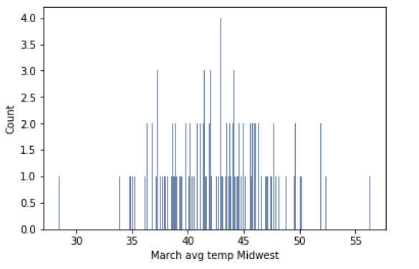
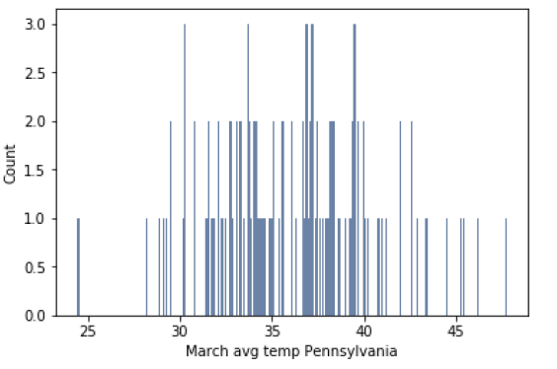
Variable Histograms
Based on the histograms, the temperature values seem acceptable, with no outliers. There are years with no values or predictions recorded, and these rows of data have been excluded from the data for analysis purposes.

Slide 6
Descriptive Analytics
 | Mean | Mode | Variance | Std Dev.
Feb Avg Temp | 33.93 | 33.69 | 10.16 | 3.19
Feb Avg Temp NE | 22.80 | 26.20 | 18.59 | 4.31
Feb Avg Temp MW | 32.91 | 31.50 | 22.05 | 4.70
Feb Avg Temp Penn | 26.69 | 23.00 | 20.12 | 4.49
March Avg Temp | 41.83 | 38.50 | 8.68 | 2.95
March Avg Temp NE | 32.47 | 32.70 | 14.97 | 3.87
March Avg Temp MW | 42.69 | 42.90 | 20.74 | 4.55
March Avg Temp Penn | 36.01 | 30.30 | 17.75 | 4.21

Slide 7
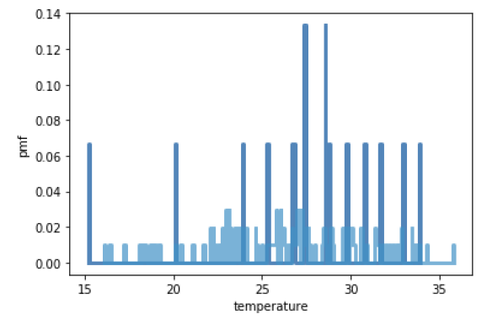
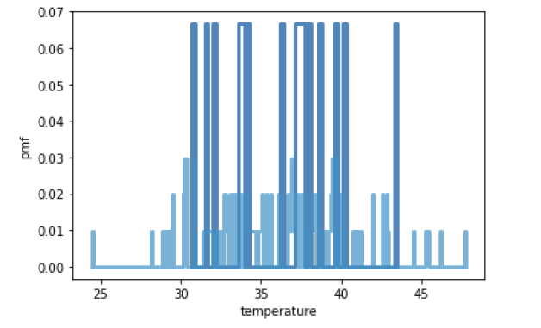
PMF Comparisons
PMF chart comparing February average temperatures for shadow vs. no shadow results
PMF chart comparing March average temperatures for shadow vs. no shadow results

Slide 8
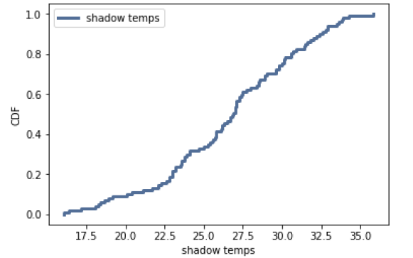
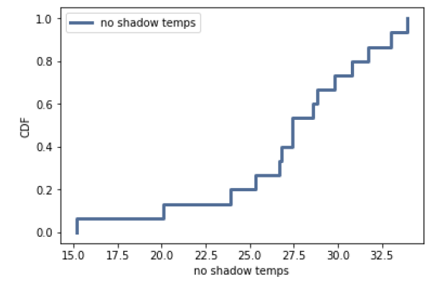
CDF Charts for February Avg Temp in Pennsylvania
These two charts compare the CDF for the average temperature in Pennsylvania in February based on shadow or no shadow results. Each approximate a normal distribution.

Slide 9
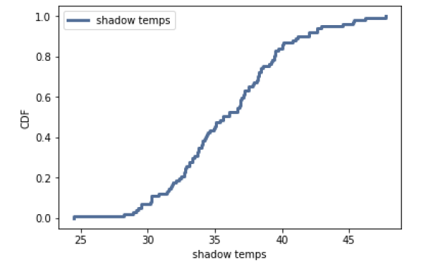
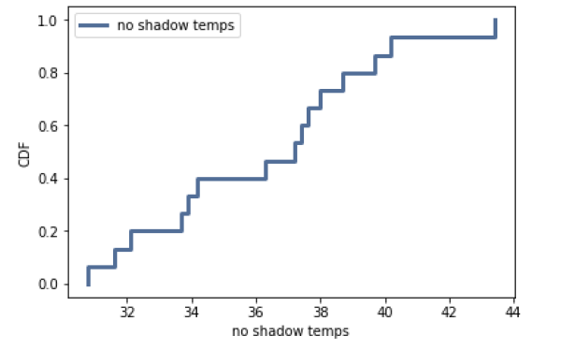
CDF Charts for March Avg Temp in Pennsylvania
These two charts compare the CDF for the average temperature in Pennsylvania in March based on shadow or no shadow results. Each approximate a normal distribution.

Slide 10
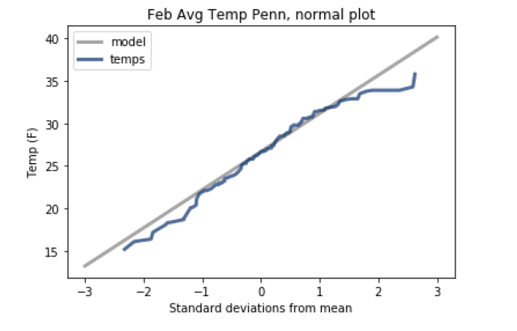
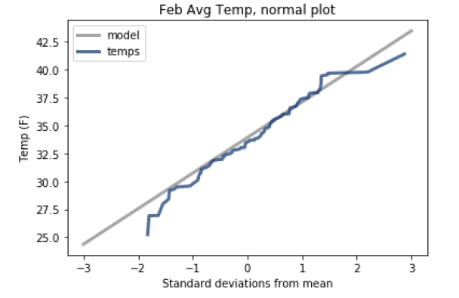
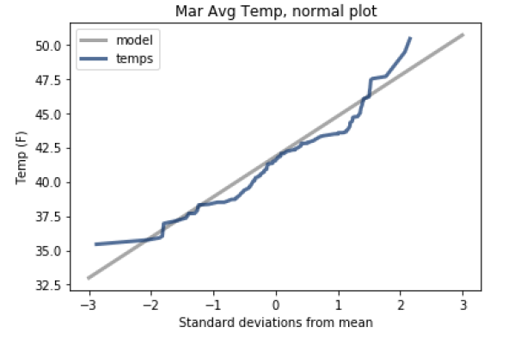
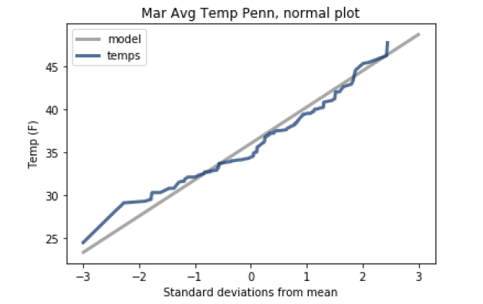
Normal Plots
The charts to the left indicate that the monthly average temperatures follow a normal distribution.

Slide 11
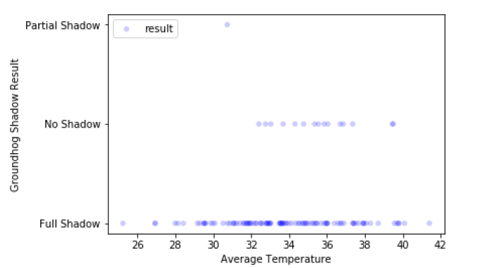
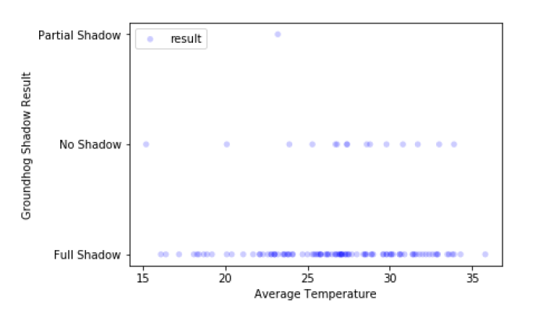
Scatter Plots
Scatter plots for February average temperatures in the entire U.S. (on the left) and Pennsylvania (on the right) plotted against the shadow results. There seems to be no correlation between the temperature and the shadow results.

Slide 12
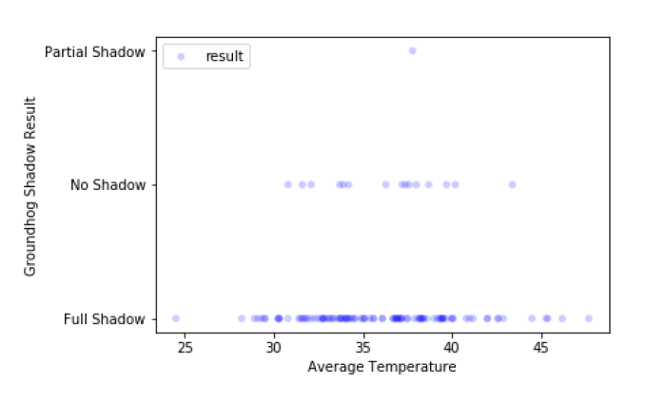
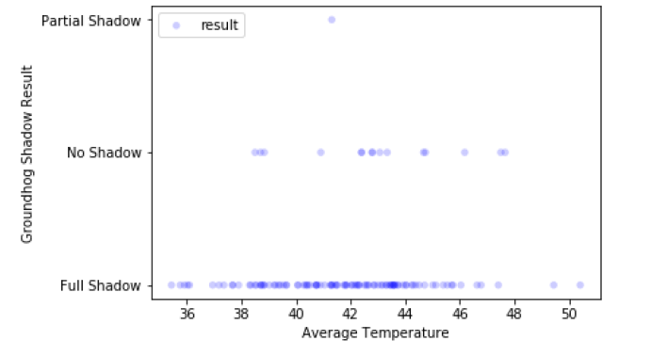
Scatter Plots
Scatter plots for March average temperatures in the entire U.S. (on the left) and Pennsylvania (on the right) plotted against the shadow results. There seems to be no correlation between the temperature and the shadow results.

Slide 13
Covariance and Correlation
 | Covariance | Correlation | Spearman's Correlation
Feb Avg Temp | -0.213 | -0.200 | -0.212
Feb Avg Temp NE | -0.090 | -0.061 | -0.093
Feb Avg Temp MW | -0.122 | -0.078 | -0.081
Feb Avg Temp Penn | -0.078 | -0.052 | -0.080
March Avg Temp | -0.146 | -0.149 | -0.144
March Avg Temp NE | -0.064 | -0.049 | -0.069
March Avg Temp MW | -0.044 | -0.059 | -0.061
March Avg Temp Penn | -0.040 | -0.028 | -0.040
There is no significant correlation between the temperatures and the prediction results of shadow or no shadow.

Slide 14
Hypothesis Testing
Difference between Means
For Shadow vs. No Shadow results
Feb Avg Temp | 0.030
Feb Avg Temp NE | 0.513
Feb Avg Temp MW | 0.395
Feb Avg Temp Penn | 0.559
March Avg Temp | 0.102
March Avg Temp NE | 0.606
March Avg Temp MW | 0.758
March Avg Temp Penn | 0.783
Correlation Permutation
Feb Avg Temp | 0.027
Feb Avg Temp NE | 0.507
Feb Avg Temp MW | 0.410
Feb Avg Temp Penn | 0.573
March Avg Temp | 0.115
March Avg Temp NE | 0.622
March Avg Temp MW | 0.757
March Avg Temp Penn | 0.770
Hypothesis testing p-values indicate that the prediction results are not statistically significant.

Slide 15
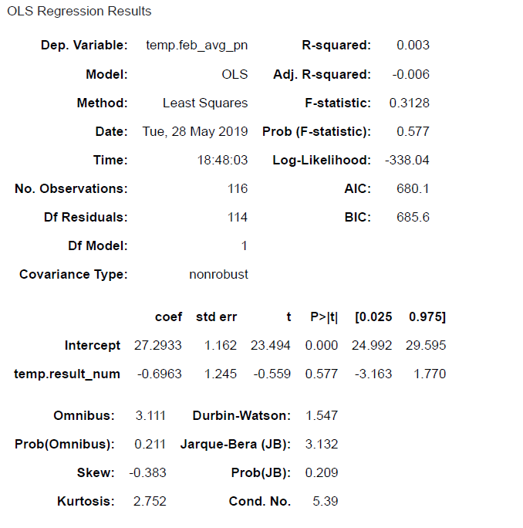
Regression Analysis
Regression model for average February temperatures in Pennsylvania as a function of the shadow prediction results. The R-squared value means that the prediction only accounts for .3% of the explanation in temperature. The F-statistic and t values indicate that the probability of the results occurring without the prediction are well over 57%.

Slide 16
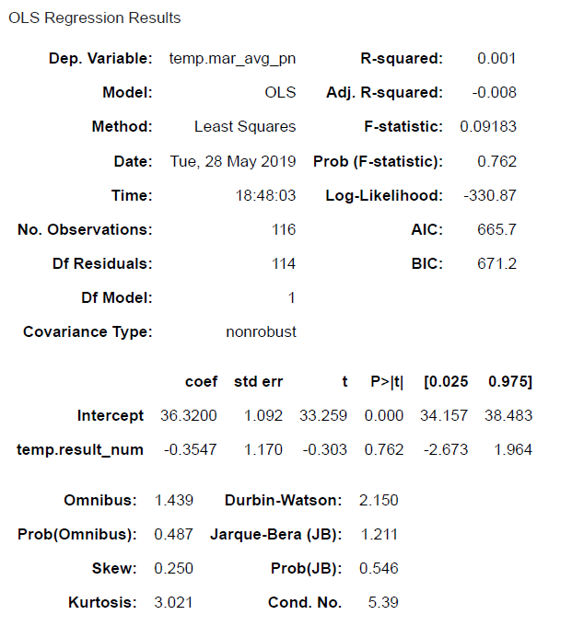
Regression Analysis
Regression model for average March temperatures in Pennsylvania as a function of the shadow prediction results. The R-squared value means that the prediction only accounts for .1% of the explanation in temperature. The F-statistic and t values indicate that the probability of the results occurring without the prediction are well over 76%.

